Slide 1
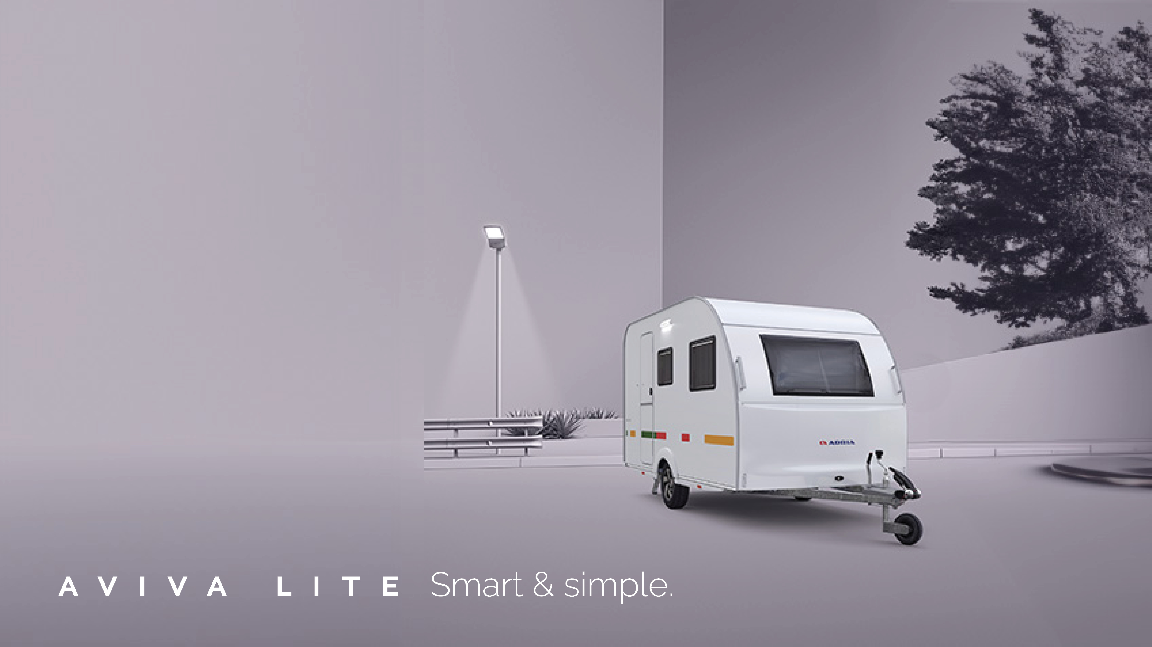


Slide 2

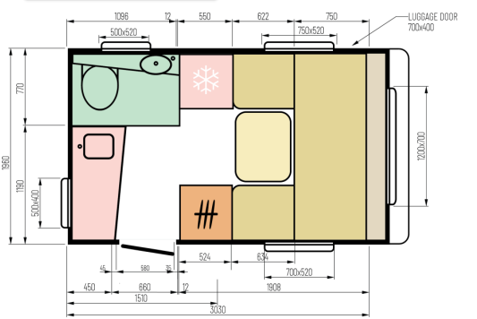
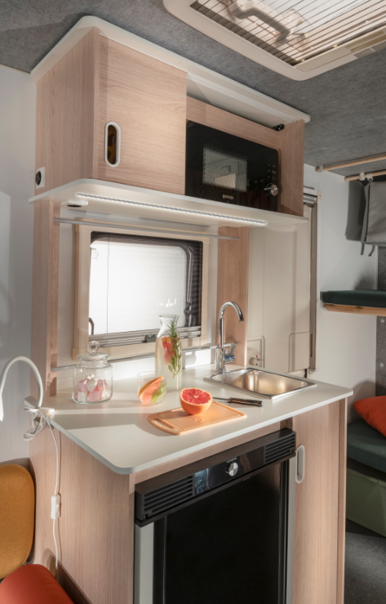
AVIVA LITE
HIGHLIGHTS
NEW floorplan 300LH – lightweight & entry price range
NEW led light above the kitchen worktop

Slide 3
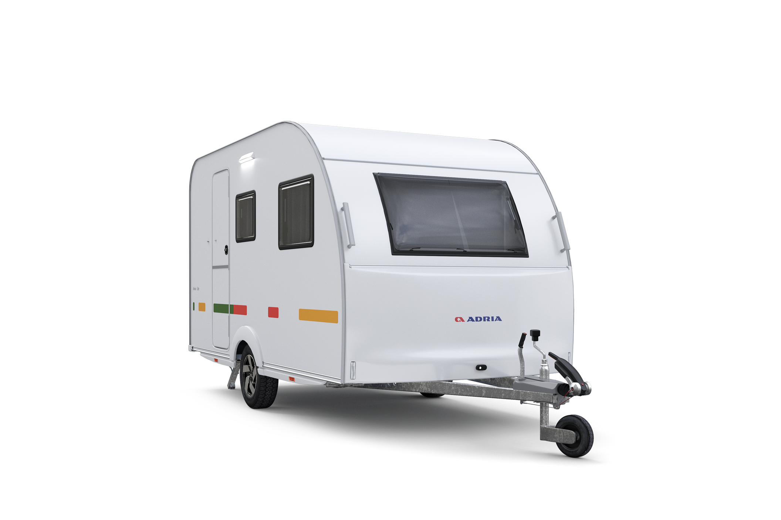
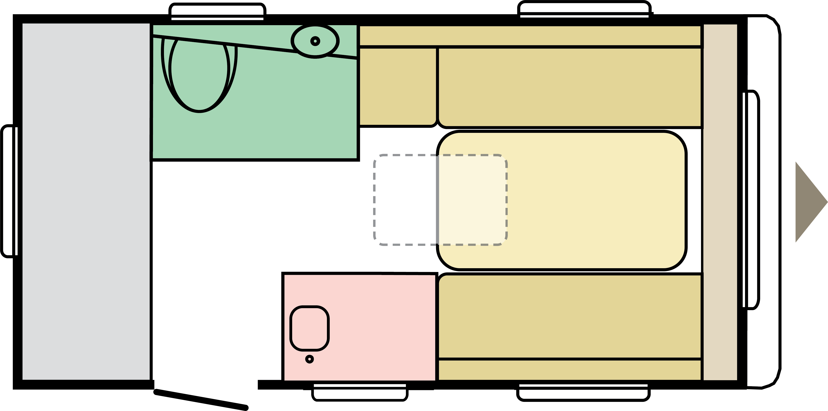
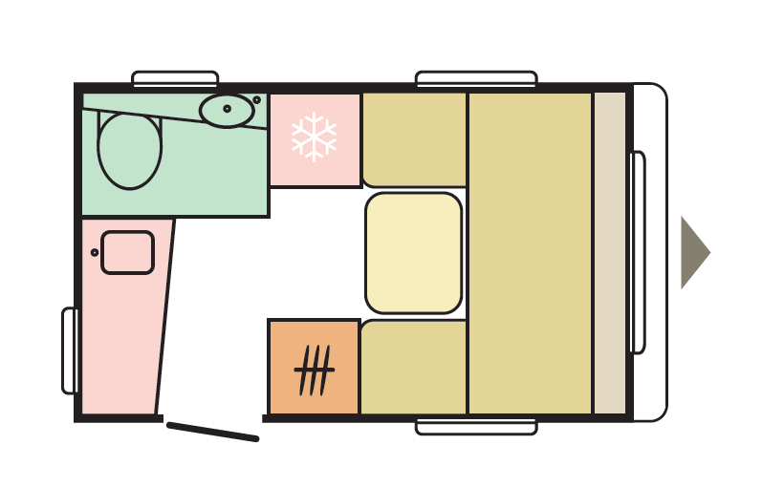
DESIGNED FOR YOU
AVIVA LITE
Two layouts, designed with flexible space and portable features, allow you to tailor the space to your specific needs.
360 DK
300 LH
4
2+1

Slide 4
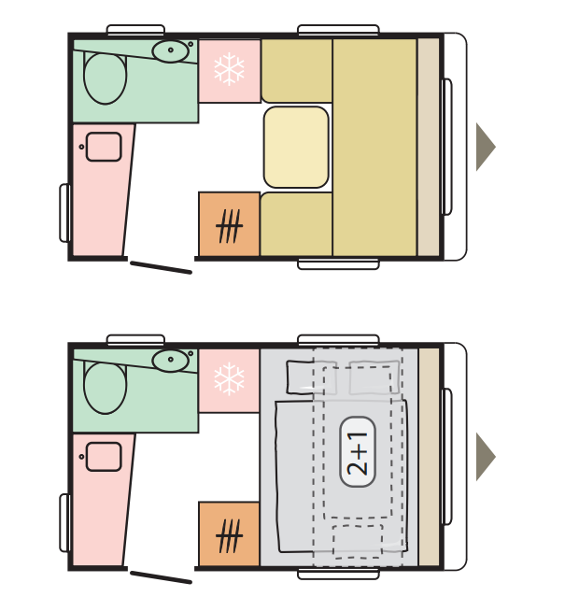
DESIGNED FOR YOU
AVIVA LITE
NEW AVIVA LITE 300 LH
A NEW 300LH is most compact layout of caravans. It adresses all with strong essential demand of lightweight easy maneuvrable caravan in afordable price and in this manner appeals in potential newcomers. In a compact, light weight (O1), minimalistic and simple caravan, with a cool funky design and all essential features you need.
.

Slide 5
AVIVA LITE
DESIGNED FOR YOU
AVIVA LITE 300 LH
DESCRIPTION
͏Front full length bed.
͏Rear panorama window of 1600mm.
͏Compact kitchen
͏dinette + day bed
͏additional hammock bed.
Compact layout for two+1 with extra storage while driving.
DIMENSIONS
1. Total length:
2. Body lengths:
3. Total width:
4. Sleeping places:
4750 mm
3610 mm
2.090 mm
2+1 berths

Slide 6
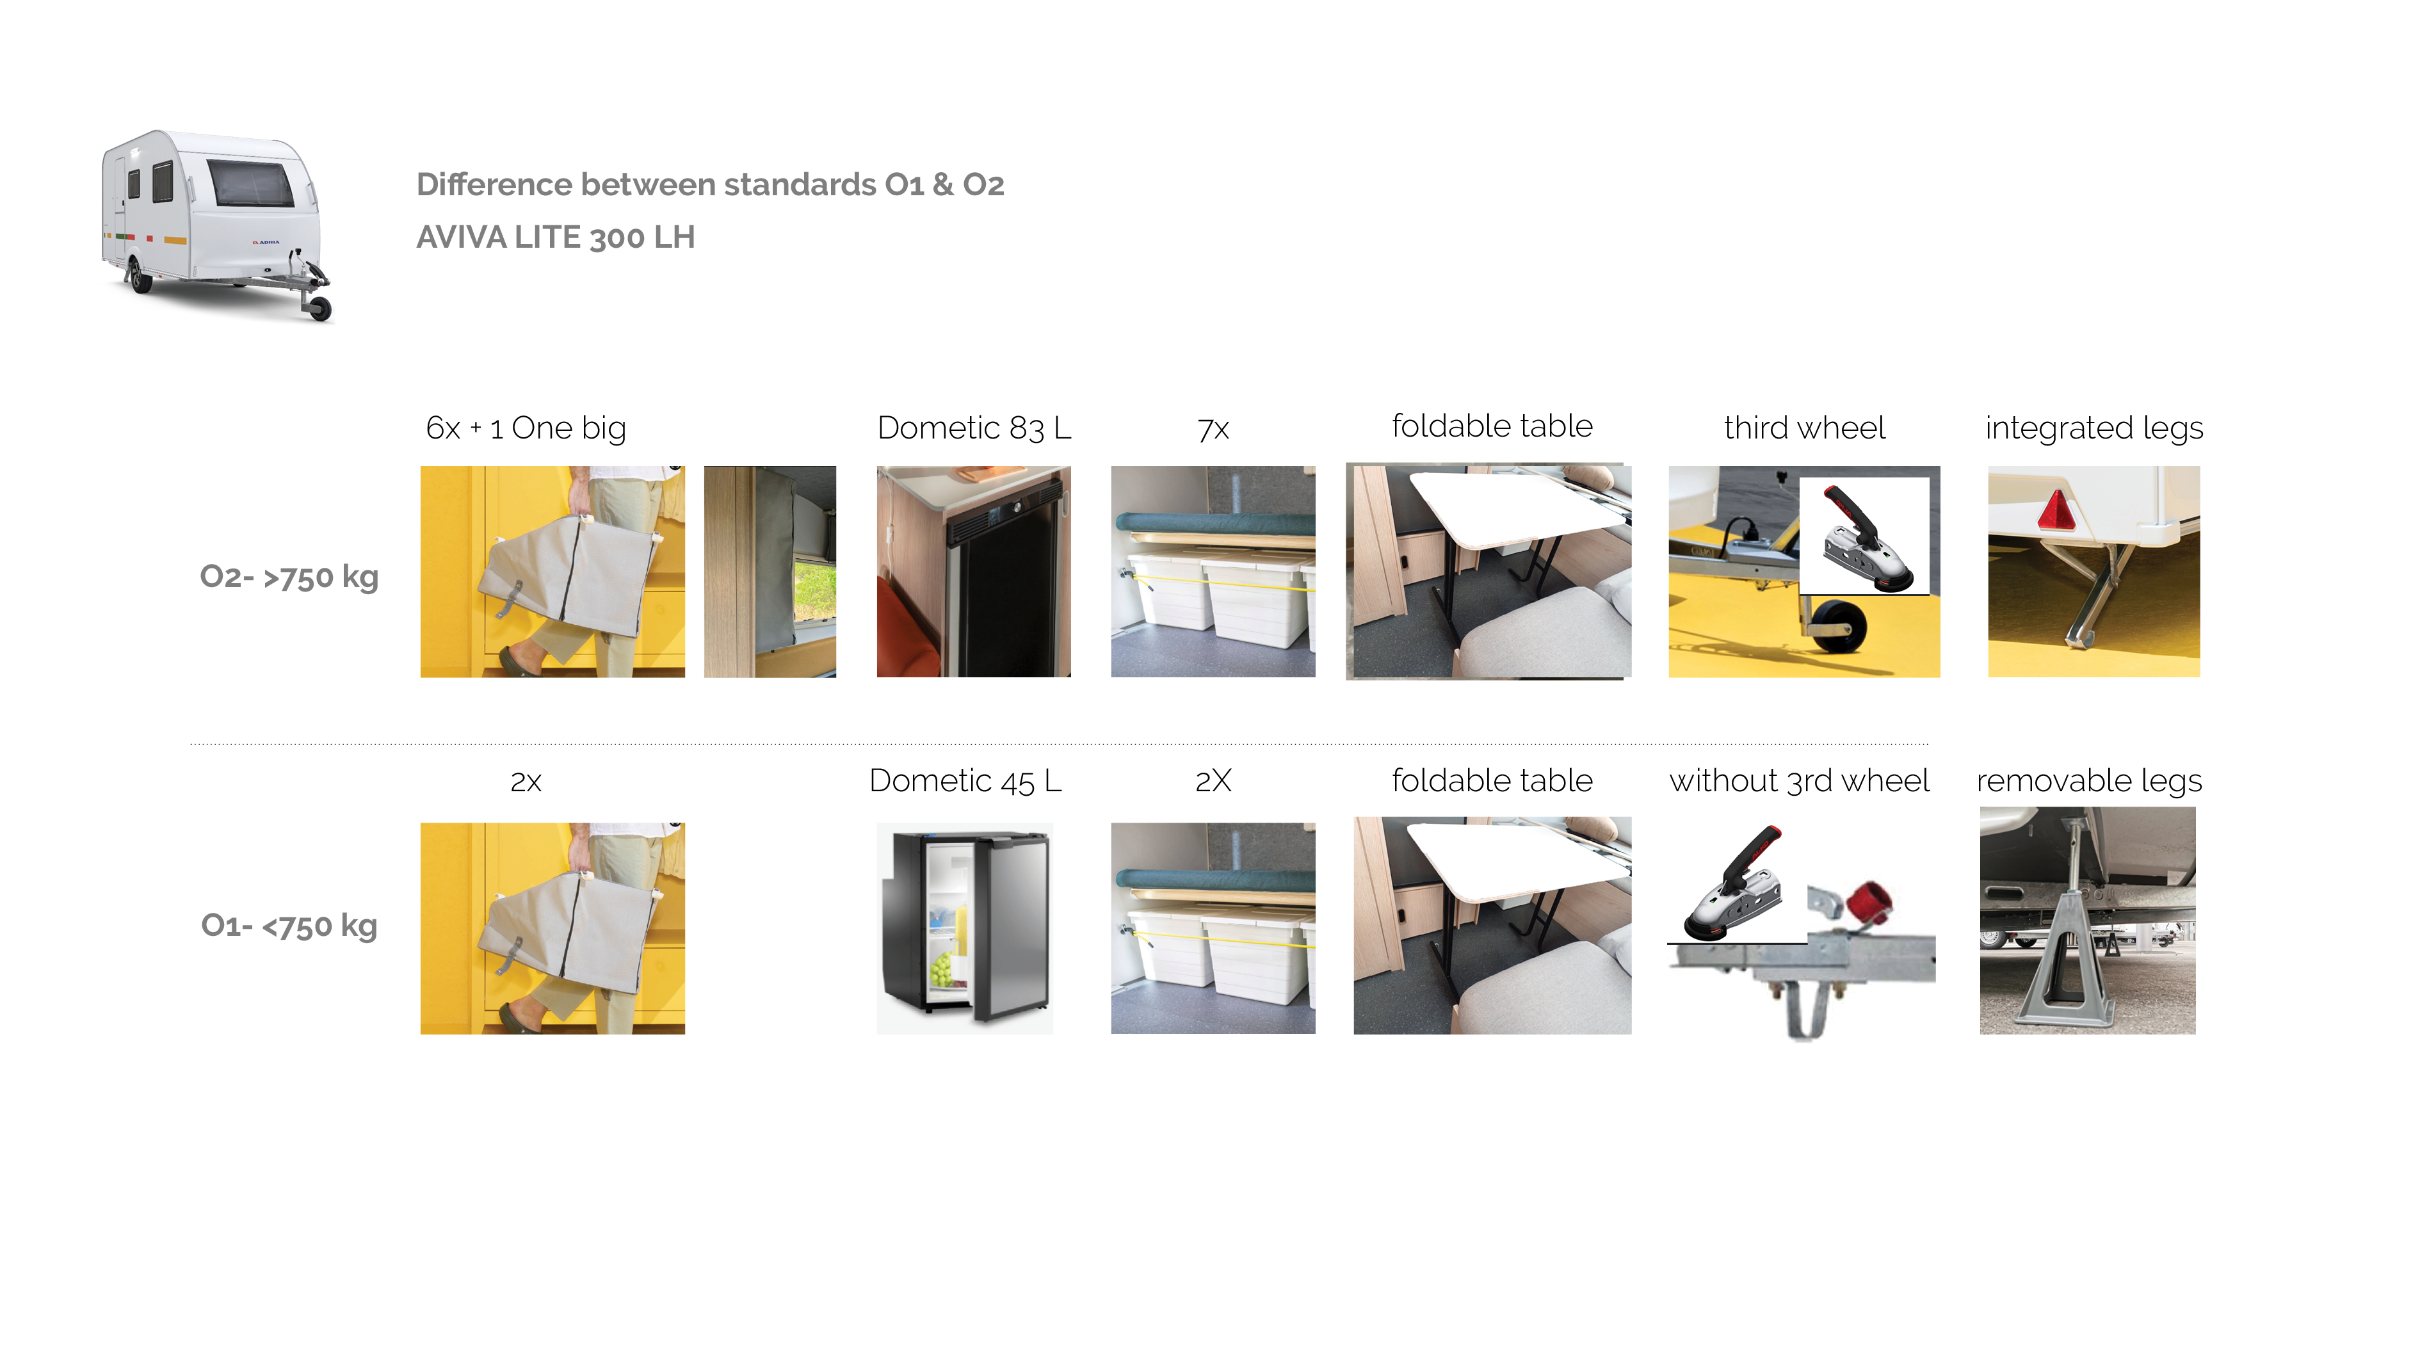
AVIVA LITE
DESIGNED FOR YOU

